Slide 1
Portfolio Evaluation Given Constraints
Brian Putt
#RISKAWARENESSWEEK2019

Slide 2
What is Portfolio Analysis
4
Clear Values
& Trade-offs
3
Meaningful
Information
Deciding whether to invest or how much to invest
Good Decision depends on
  Having wide range of alternatives
  Reasonable data
  Assessment of uncertainty
  Understanding our value measures and risk preferences
Applicable to financial instruments or projects
2
Creative
Alternatives
Decision
Quality
5
Logical
Reasoning
1
Appropriate Frame
6
Commitment
to Action
Source: Spider Diagram attributed to Strategic Decision Group
Today we will consider a portfolio of ETF (Electronically Traded Funds)

Slide 3
Portfolio of ETFs – How do we invest to achieve our objectives
ROR / IRR
Consider 6 ETFs
S&P 500 (SPY)
Mid Cap (MDY)
Dow Jones Industrials (DIA)
Small Growth (SLYG)
Small Value (SLYV)
Energy (XLE)
NPV
Profitability Index (PI)
Risk reduction
Environmental Damage
Reliability
Maximize the P10
Sharpe Ratio

Slide 4
Qualities of a Good Decision
Frame includes the stocks or ETFs to consider.
Clear values includes our risk tolerance
Meaningful information can come from history relationships
Alternatives are covered by the analysis and optimizations in combination with the value measures
Logical Reasoning achieved through simulation that can be understood
Commitment to Action comes from working the model to gain confidence.
4
Clear Values
& Trade-offs
3
Meaningful
Information
2
Creative
Alternatives
Decision
Quality
5
Logical
Reasoning
1
Appropriate Frame
6
Commitment
to Action
Source: Spider Diagram attributed to Strategic Decision Group

Slide 5
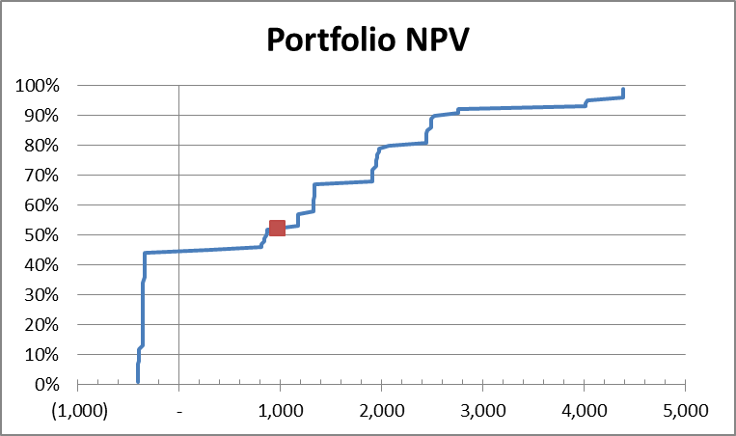
“Downside” is a great word, but what does it mean analytically?
How do we measure downside?
  Probability of loss (~45%)
  Mean Loss ($164)
  Deviation from the mean (Standard Deviation) (1435)
  Probability of being less than the Expected Value (52%)
  Mean of outcomes when less than the Expected Value (Semi-Deviation) (657)
  Probability of being less than 1500 (68%)
(Sample)
Management Needs to define “downside” or “risk”
6
1
3
4
5
2
Notes:
See Graphic below for Semi-deviation definition.
Graphic reflects Asset A

Slide 6
Resampling is a technique to incorporate uncertainty based on prior history
Given a decision policy (portfolio) we can use resampling to incorporate uncertainty based on the historical uncertainty.
We will use data from 2001 through 2016
Bootstrapping is a statistical method for estimating the sampling distribution of an estimator by sampling with replacement from the original sample, most often with the purpose of deriving robust estimates of standard errors and confidence intervals of a population parameter like a mean, median, proportion, odds ratio, correlation coefficient or regression coefficient. It may also be used for constructing hypothesis tests. It is often used as a robust alternative to inference based on parametric assumptions when those assumptions are in doubt, or where parametric inference is impossible or requires very complicated formulas for the calculation of standard errors

Slide 7
Resampling could be selective
Exclude periods that we think are unlikely to repeat
Include periods that we believe are characteristic of the future (rising interest rates) and exclude those that are not characteristic.

Slide 8
Features of the SIPmath Portfolio Model
Complete flexibility to specify the portfolio
Transparency in the results
Automatic updates of results with changes of inputs or decision criteria
Results consolidated on Dashboard that can be modified to user requirements.
Graphics easily copied to PowerPoint, Word or other application.
Works with Excel’s Solver – free non-linear optimization algorithm

Slide 9
Time to Get Into the Portfolio Model
Do you know your value measures or decision criteria??
Do you know your attitude to risk?
At the end of this session you may have a better idea

Slide 10
What have we learned?
Better idea about our value measure?
There are many ways to measure “risk”
A way of considering our attitude to risk is through graphics
Rate of Return or IRR can be calculated in many ways so be careful using the metric
Simulation provides flexibility that simple EV economics fail to deliver.
Analysis is applicable to all sorts of portfolio whether stock or projects.

